Slide 1

Essential Functions for Calculus
CSM PRESS 2025

Slide 2
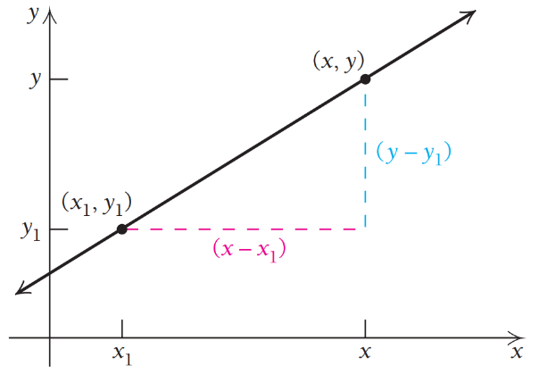
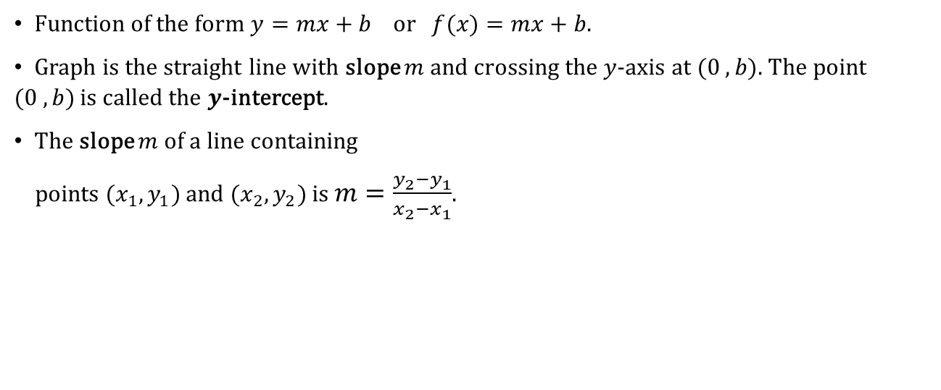
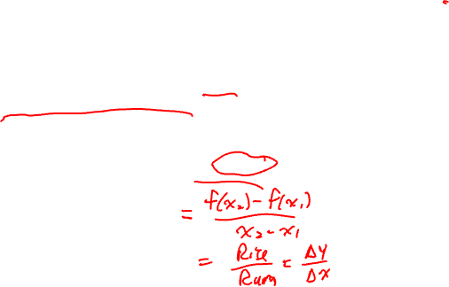
Linear Functions
Function of the form $y=mx+b$ or $f(x)=mx+b$.
Graph is the straight line with slope $m$ and crossing the $y$-axis at $(0 , b).$ The point $(0 ,b)$ is called the $y$-intercept.
The slope $m$ of a line containing
points $(x_{1},y_{1})$ and $(x_{2},y_{2})$ is $m=\frac{y_{2}−y_{1}}{x_{2}−x_{1}}$.

Slide 3

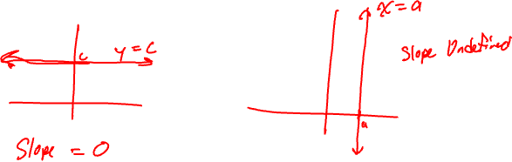
Constant Functions
A constant function of the form $y=c$ or $f(x)=c$, for some real number $c.$ The graph of $f(x)=c$ (or $y=c$) is a horizontal line.
Vertical lines are given by the equation $x=a$, for some real number $a$. Vertical lines are NOT functions.

Slide 4
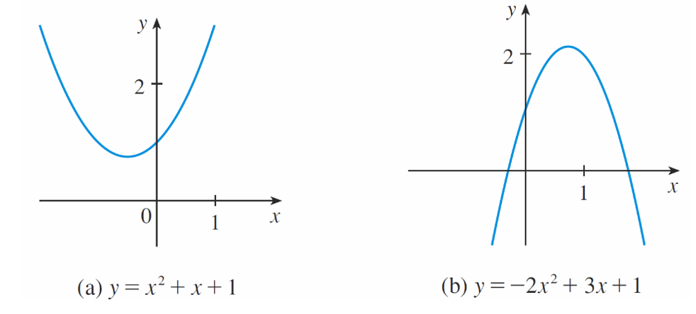
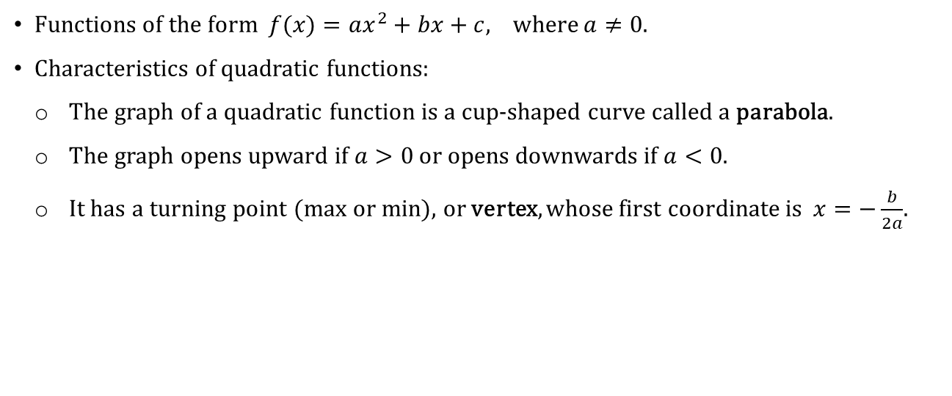

Quadratic Functions
Functions of the form $f(x)=ax^{2}+bx+c,$ where $a≠0$.
Characteristics of quadratic functions:
  The graph of a quadratic function is a cup-shaped curve called a parabola.
  The graph opens upward if $a>0$ or opens downwards if $a<0$.
  It has a turning point (max or min), or vertex, whose first coordinate is $x=−\frac{b}{2a}$.

Slide 5

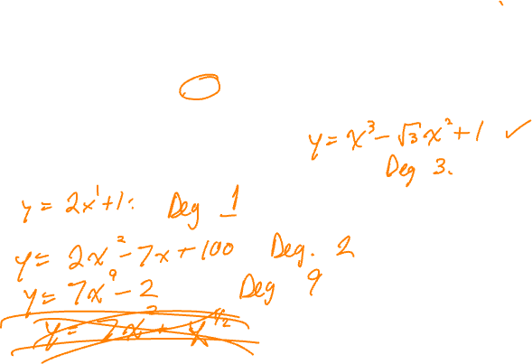
Polynomial Functions
Function of the form $f\left(x\right)=a_{n}x^{n}+a_{n−1}x^{n−1}+ …+a_{2}x^{2}+a_{1}x+a_{0}$, where $n$is a nonnegative integer (called the degree of the polynomial) and $a_{n}, a_{n−1},…,a_{2},a_{1},a_{0}$ are real numbers, called the coefficients.
The domain of any polynomial is $\left(−∞,∞\right)$.
EXAMPLES:

Slide 6

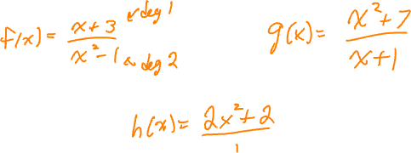
Rational Functions
Functions that are given by a quotient, or ratio, of two polynomials. Rational functions have the form $f(x)=\frac{P(x)}{Q(x)}$ , where $P(x)$ and $Q(x)$ are polynomials.
The domain of a rational function are all input values that do not result in division by $0$.
EXAMPLES:

Slide 7
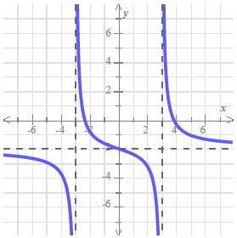
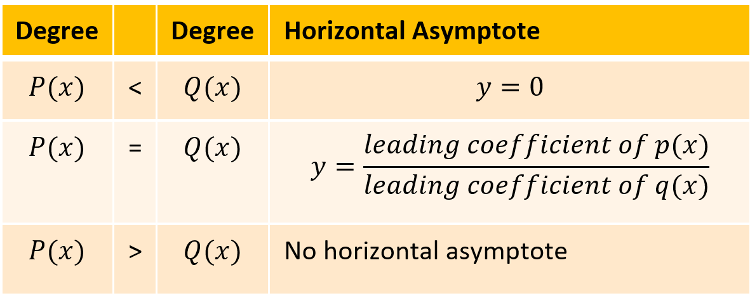


Rational Functions
Rational functions often have asymptotes.
Vertical Asymptote: Occurs where function value magnitudes grow larger as $x$ approaches a fixed number. With rational functions, to find the vertical asymptotes, we determine the values of $x$ that make the denominator equal to 0 in the fully simplified rational function.
Horizontal Asymptote: occur when a function approaches a horizontal line as $x$ approaches positive or negative infinity. With a rational function $f(x)=\frac{P(x)}{Q(x)}$, we consider the table.

Slide 8

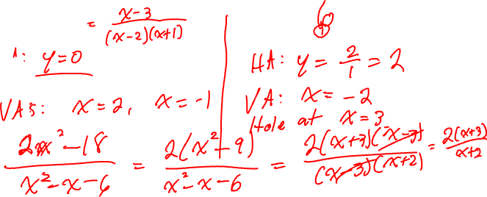
Rational Functions
Ex. Find the horizontal and vertical asymptotes of
$f(x)=\frac{x−3}{x^{2}− x −2}$ $g\left(x\right)=\frac{2x^{2}−18}{x^{2}−x−6}$

Slide 9

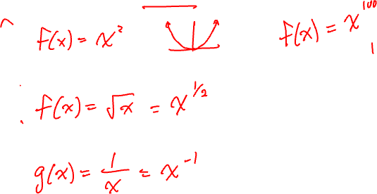
Power Functions
Function of the form $f(x)=x^{n}$, where $n$ is a constant.
CASE 1: $n$is a positive integer.
CASE 2: $n=\frac{1}{k}, where k$ is a positive integer.
CASE 3: $n=−k$, $where k$ is a positive integer.

Slide 10

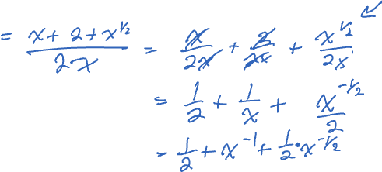
Power Function Examples
Ex. Write the given function as a sum/difference of power functions.
$$\frac{x+2+\sqrt{x}}{2x}$$

Slide 11
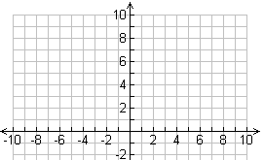

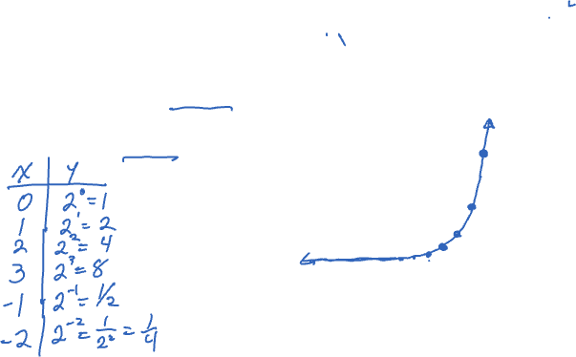
Exponential Functions
Functions of the form $f(x)=b^{x}$ , where the base $b$ is a constant such that $b>0$ and $b≠1$, and $x$ is any real number.
Example: Graph $y=2^{x}$.

Slide 12
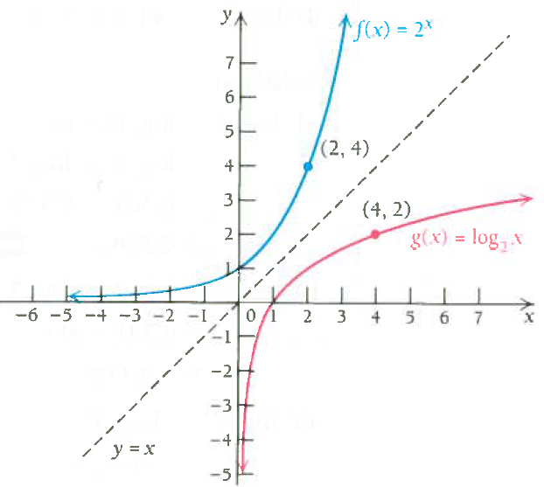
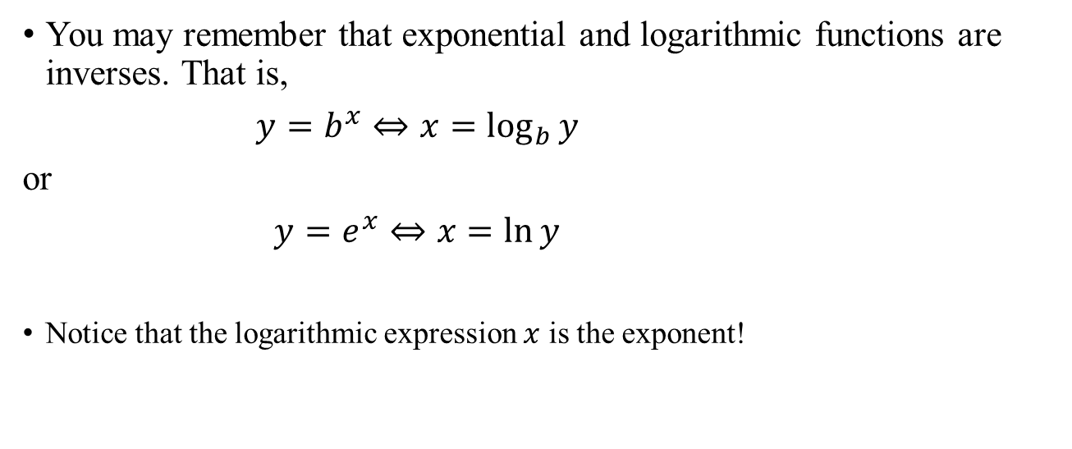
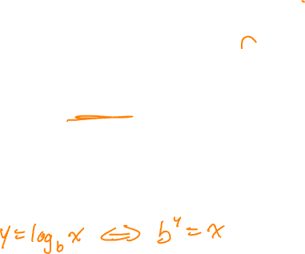
Exponential and Logarithmic Functions
You may remember that exponential and logarithmic functions are inverses. That is,
$y=b^{x}⇔x=\log_{b}{y}$
or
$y=e^{x}⇔x=\ln{y}$
Notice that the logarithmic expression $x$ is the exponent!

Slide 13
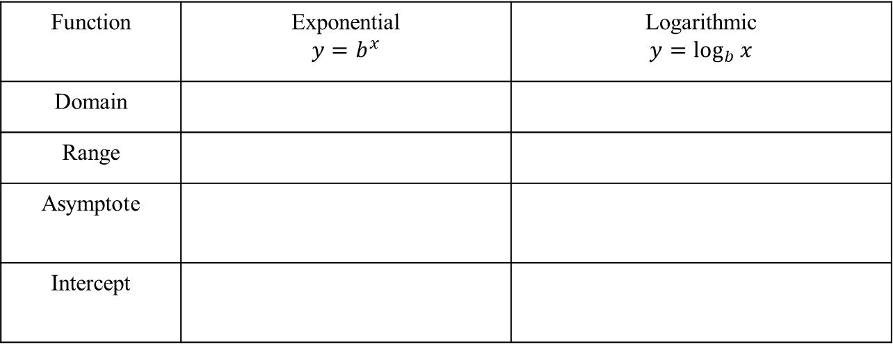
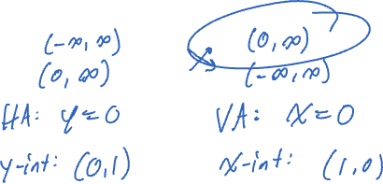
Domain and Range
Function | Exponential $$y=b^{x}$$ | Logarithmic $$y=\log_{b}{x}$$
Domain
Range
Asymptote
Intercept

Slide 14
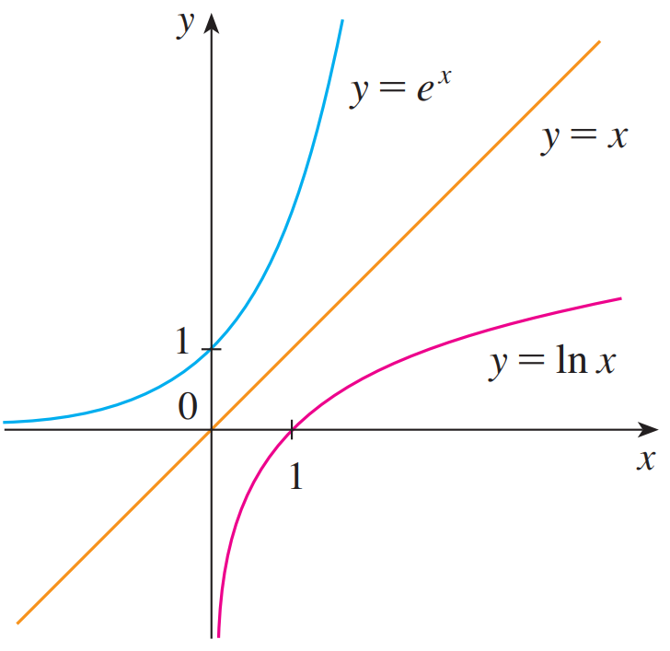


Special Bases
Euler’s Number: $e$ is an irrational number (like $π$, it is NOT a variable).
$$e≈2.71828182846$$
We call the function $f\left(x\right)=e^{x}$ the natural exponential function.
We call the function $f\left(x\right)=\log_{e}{x}=\ln{x}$ the natural logarithm function.

Slide 15
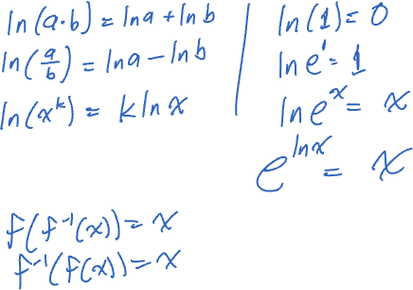
Properties Of LOGARITHMIC FUNCTIONS

Slide 16

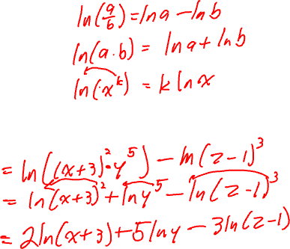
Examples
Expand each expression.
a. $\ln\left(x^{3}{\left(y−1\right)}^{2}\right)$
b. $ln\left(\frac{{\left(x+3\right)}^{2}y^{5}}{{\left(z−1\right)}^{3}}\right)$

Slide 17

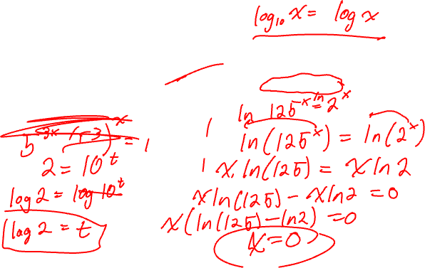
Solving Equations
When there is a variable in the exponent, writing the equation as a logarithm is helpful.
Ex. $2={10}^{t}$Ex. $5^{3x}=2^{x}$

Slide 18

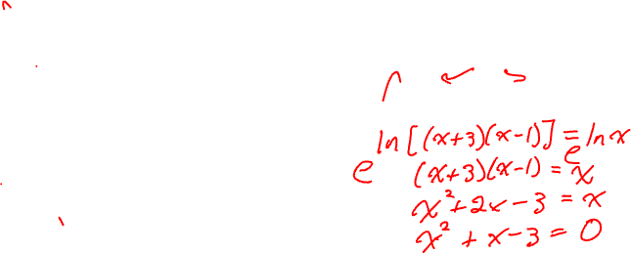
Solving Equations (cont.)
When there is a variable in the logarithm, writing the equation as an exponent is helpful.
Ex. $\log\left(x+5\right)=2$Ex. $\ln\left(x+3\right)+\ln\left(x−1\right)=ln⁡(x)$

